Slide 1
GSERM: Text Mining & NLP Sentiment Analysis
Ted Kwartler

Slide 2
Agenda – all times are suggested
Start | End | Wednesday
8:45 | 9:15 | Coffee
9:15 | 9:30 | Review Q/A from yesterday
9:30 | 10:45 | Polarity & Sentiment
10:45 | 11:00 | Break
11:00 | 12:00 | Topic Modeling
12:00 | 1:30 | Lunch
1:30 | 2:30 | K-Means, Spherical K-Mean, K-Mediod Clustering
2:30 | 3:15 | Lab

Slide 3
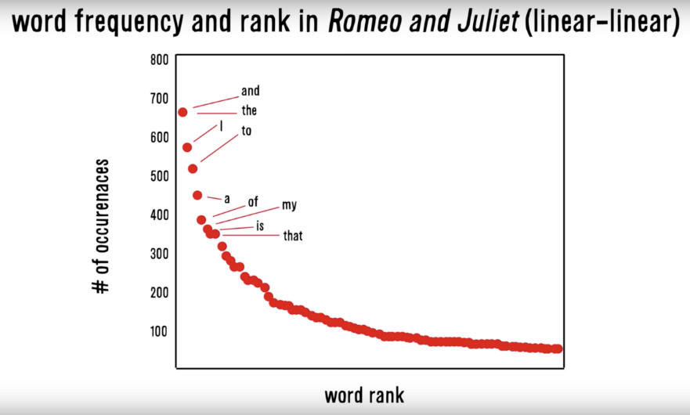
Zipf’s Law: Our words are less diverse than we think
Another Example
Many words in natural language but also a steep decline in actual usage. Follows a predictable pattern.

Slide 4
Why do we see Zipf’s law in linguistics?
Principle of Least Effort Theory
Humans will choose a path of least resistance
Humans seek to minimize effort for a task
Therefore, even if we know 000s of words, we will use as few as possible to communicate.

Slide 5
Polarity
To what extent is a document positive or negative.

Slide 6
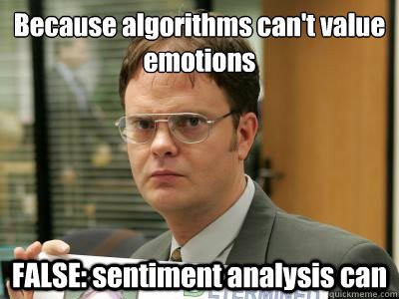
Let’s see if we can do it

Slide 7
How would you rate the polarity?
I loathe Aldi.
I love Carrefour. They are the best.
I like shopping at Migros but hate the location.

Slide 8
How would you rate the polarity?
I loathe Aldi.
I love Carrefour. They are the best.
I like shopping at Migros but hate the location.

Slide 9
How did you do that?
-1
I loathe Aldi.
I love Carrefour. They are the best.
I like shopping at Migros but hate the location.
+2
+1
-1
0
You know groups of positive and negative words. These could be called a polarity lexicon

Slide 10
Simple Sentiment Polarity
Lexicon
Zipf’s Law
Because of Zipf’s Law you can have pos/neg lexicons that do not encompass all possible terms.
Many words in natural language but there is steep decline in everyday usage. Follows a predictable pattern.
library(qdap)
polarity()
library(tidytext) & library(dplyr)
inner_join()

Slide 11
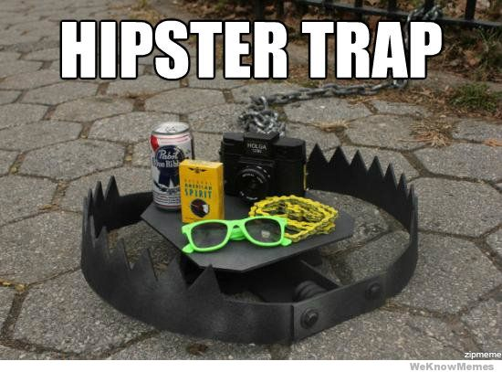
Differences between Polarity & Emotion
Polarity isn’t an emotion
Surprise is an emotion
Some emotions can be positive & negative
Surprise! You won the lottery!!

Slide 12
Differences between Polarity & Emotion
Polarity isn’t an emotion
Surprise is an emotion
Some emotions can be positive & negative
Surprise! You were hit by a bus!!

Slide 13
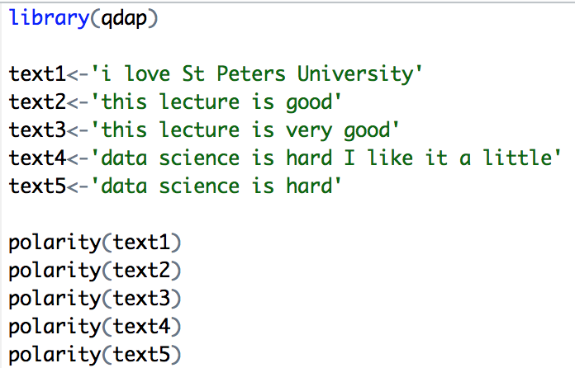
A bit more complex polarity
Scoring
Text 1: “love” was identified as positive. The text has 5 words and so 1/sqrt(5) = .447
Text 2: “good” was identified positively. So 1/sqrt(4)=.5
Text 3: “good” was found along with the amplifier “very”. So (.8+1)/sqrt(5)=.805
Text 4: hard and like cancel each other out so the polarity is zero. 1-1/sqrt(9)=0
Text 5: “hard” is -1/sqrt(4)=-.50
First it looks for the polarized word. Then identifies valence shifters (default 4 words before and two words after) Amplifiers are assigned +.8 and de-amplifiers weight is constrained to -1. Lastly the sum is divided by the square root of the total number of words in the passage.

Slide 14

Let’s use our computers!
Open A_polarity explanation.R

Slide 15
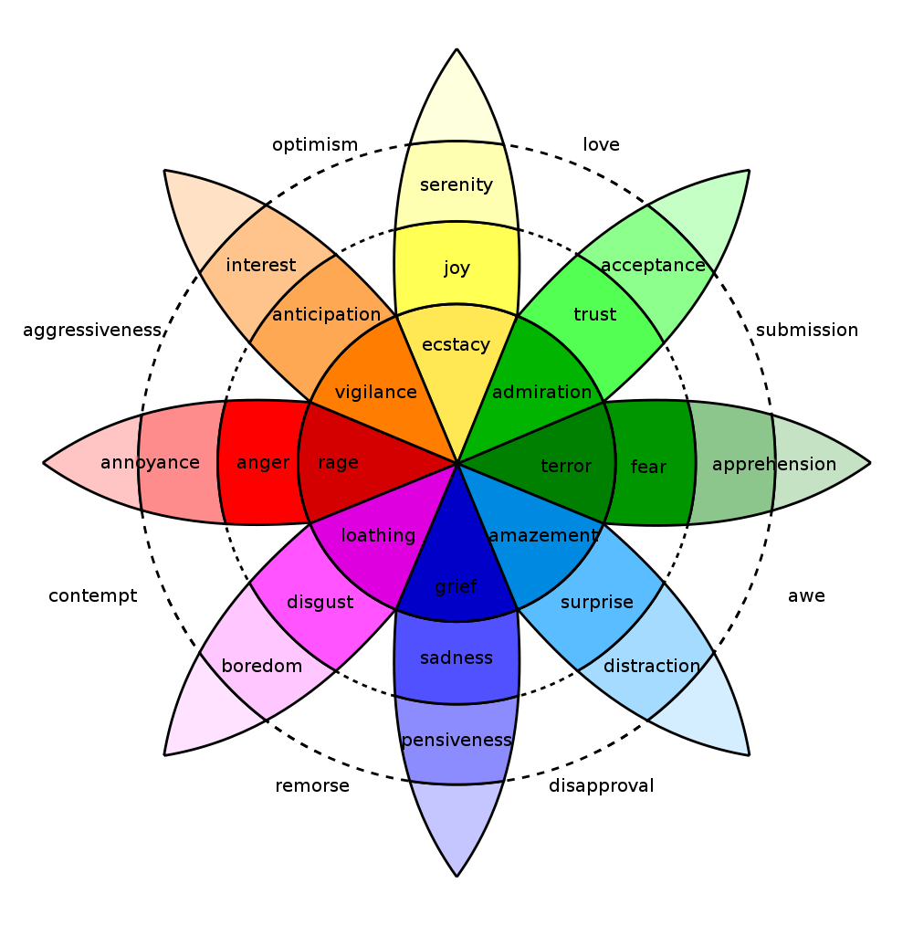
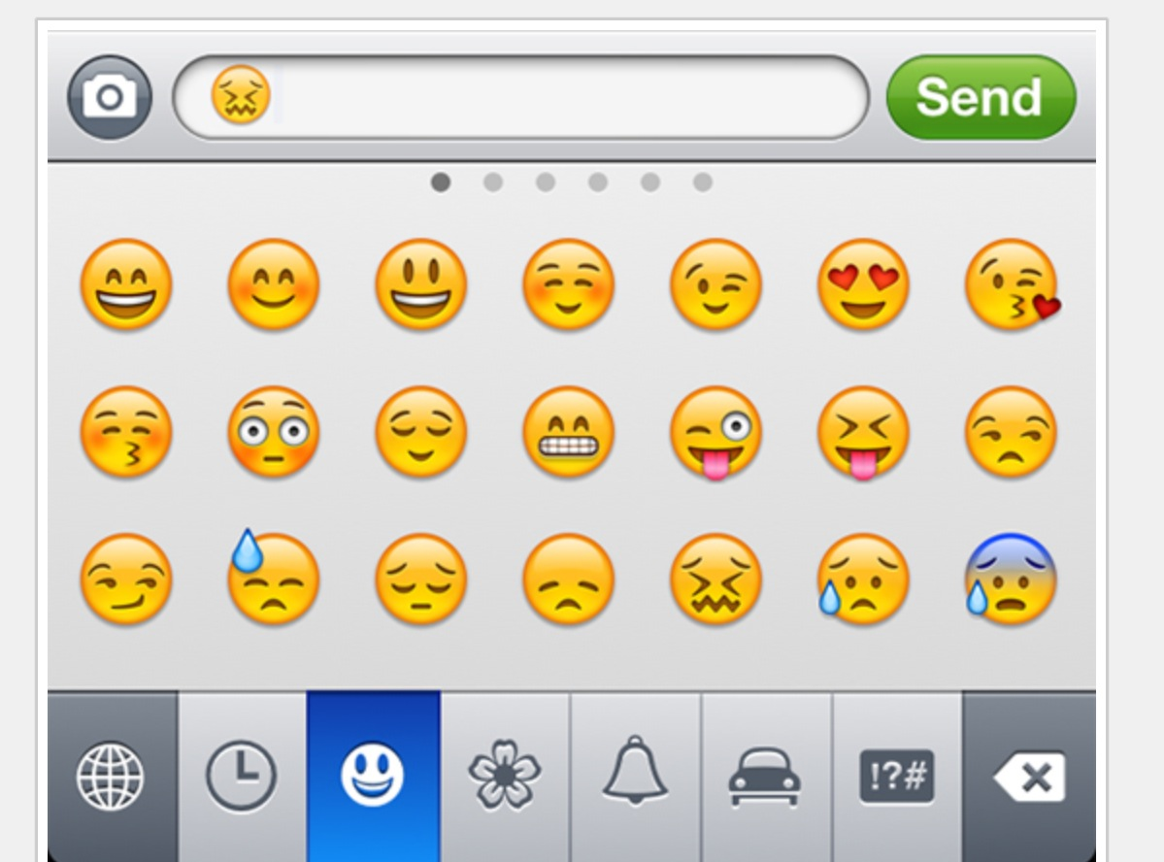
In reality sentiment is more complex.
Many Many Emoji
Plutchik’s Wheel

Slide 16
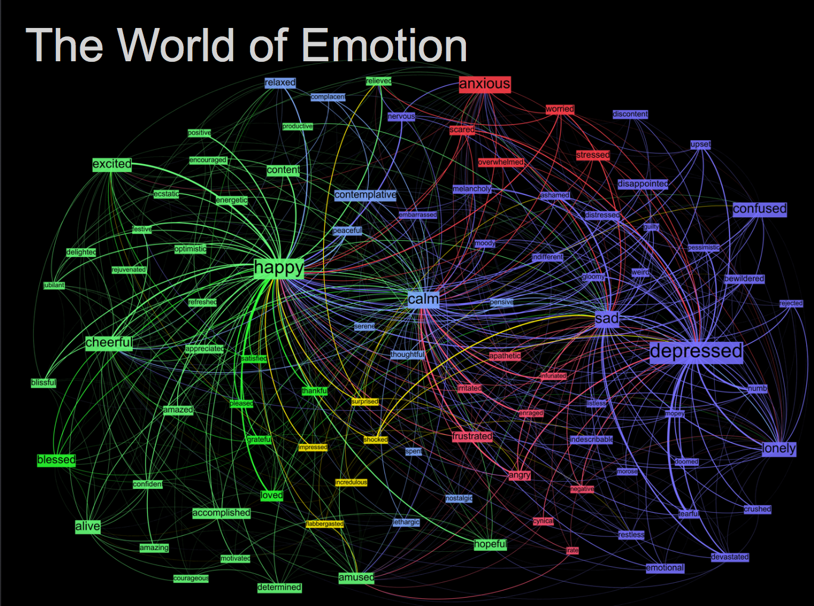
Kanjoya’s Experience Corpus

Slide 17
Tidy Data Formats are structured differently
Tidy Form (Triplet, Dense Data)
Document Term Matrix
Document | Term | count
Tweet1 | Term2 | 1
Twee1 | term3 | 1
Tweet2 | Term2 | 1
Tweet3 | Term… | 3
Tweet… | Term… | 1
Tweet… | Term_n | 1
Tweet_n | Term… | 1
 | Term1 | Term2 | Term3 | … | Term_n
Tweet1 | 0 | 1 | 1 | 0 | 0
Tweet2 | 0 | 1 | 0 | 0 | 0
Tweet3 | 0 | 0 | 0 | 3 | 0
… | 0 | 0 | 0 | 1 | 1
Tweet_n | 0 | 0 | 0 | 1 | 0

Slide 18

The pipe operator…%>%

Slide 19
Tidy data uses %>% to forward objects
Tidytext is part of the tidy universe including ggplot and dplyr. Code is structured so it is more easily read using the %>%. The data format is a tibble and is in “tidy” format (long form).
mtcars %>% group_by(cyl) %>% mutate(rank = min_rank(desc(mpg)))
This reads as “Using the mtcars object then group by the cyl vector then mutate a new variable called rank.

Slide 20
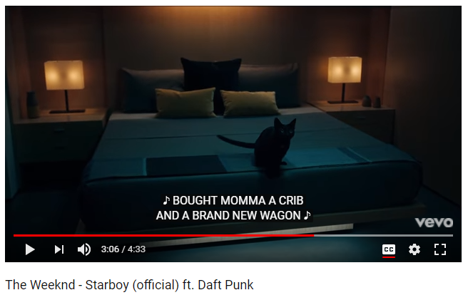
In this exercise we will examine song lyrics

Slide 21
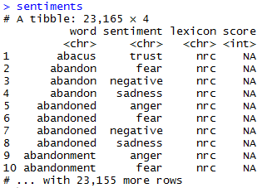
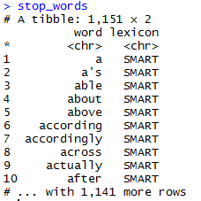
Sentiment the Tidy Way uses joins with existing lexicons
##Tidy Sentiment Analysis
data(sentiments)
sentiments
#Stopwords
data(stop_words)
stop_words
#Add stopwords
stops <- data.frame(word=c('amp','beer'),
lexicon='custom')
stop_words <- rbind(stop_words,custom.stopwords)
* Due to some changes, the first time you use a sentiment lexicon, you will be asked to download. This is due to licensing.

Slide 22
Tidy can seem complicated but not impossible.
The pipe operator
%>%
Forwards an object so the code is easy to understand & concise.
all.tidy <- all.tidy %>%
anti_join(stop_words)
Song text
Stop words
anti_join()
all.sentiment <- all.tidy %>%
inner_join(nrc.lexicon) %>%
count(tweet,sentiment) %>%
spread(tweet, n, fill = 0)
Sentiment
words
Song text
inner_join()

Slide 23
Starting with a DTM, its straightforward
# DTM
txtDTM <- DocumentTermMatrix(txtCorpus)
# Tidy
tidyCorp <- tidy(txtDTM)
# Get bing lexicon
bing <- get_sentiments(lexicon = c("bing"))
# Perform Inner Join
bingSent<-inner_join(tidyCorp,
bing, by=c('term'='word'))
DTM is from the “tm” library
Easy way to make it into a tibble.
Weeknd Lyrics
Bing Lexicon
* Due to some changes, the first time you use a sentiment lexicon, you will be asked to download. This is due to licensing.

Slide 24

Get in touch with our feelings…
Open B_sentimentAnalysis.R

Slide 25
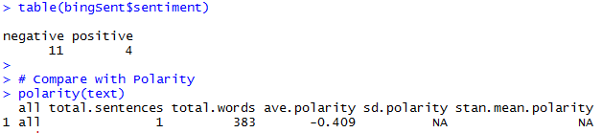
Similar polarity scores in both methods
Qdap’s polarity function calculates -0.409 for “Starboy” lyrics.

Slide 26
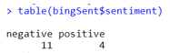
Similar polarity scores in both methods
Weeknd Lyrics
Bing Lexicon
Although less sophisticated and the scale is different, tidytext’s polarity is still negative

Slide 27
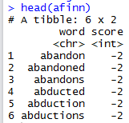
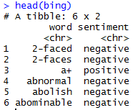
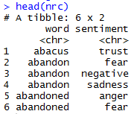
TidyText has other sentiment lexicons
AFINN- Dutch researcher
Words scored -5 to 5
Bing- U of I-Chi Researcher
Words scored Pos/Neg
NRC – mTurk
Words classified into 8 primary & pos/neg
Weeknd Lyrics
Sentiment Lexicon
Each can be used in an inner join to get different ways of assessing sentiment.

Slide 28
Let’s recreate Plutchik’s Wheel of Emotions
Back to the script!

Slide 29
Agenda – all times are suggested
Start | End | Wednesday – June 19
8:45 | 9:15 | Coffee
9:15 | 9:30 | Review Q/A from yesterday
9:30 | 10:45 | Polarity & Sentiment
10:45 | 11:00 | Break
11:00 | 12:00 | Topic Modeling
12:00 | 1:30 | Lunch
1:30 | 2:30 | K-Means, Spherical K-Mean, K-Mediod Clustering
2:30 | 3:15 | Lab

